Slide 1
The Ford-Fulkerson method

Slide 2
Ford-Fulkerson method
3 important ideas
Residual Network
A residual network graph indicates how much more flow is allowed in each edge in the network graph.
Augmenting Paths
An augmenting path is a simple path from source to sink which do not include any cycles and that pass only through positive weighted edges.
Cut - the maximum amount of flow passing from the source to the sink is equal to the total weight of the edges in a minimum cut.

Slide 3
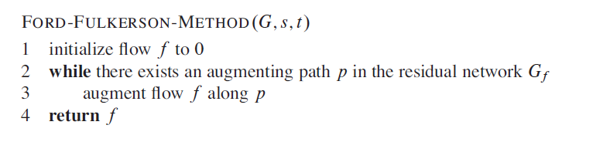
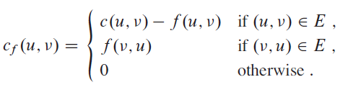
Ford-Fulkerson method
Residual Capcity

Slide 4
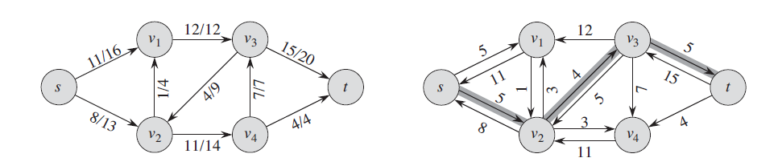
Ford-Fulkerson method

Slide 5
Ford-Fulkerson method

Slide 6
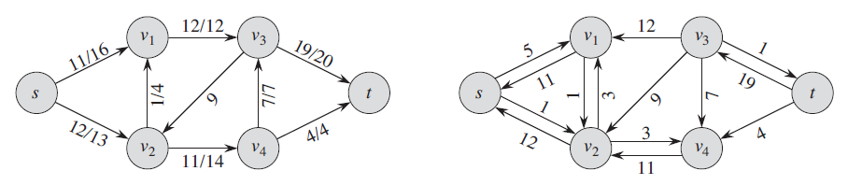
Ford-Fulkerson method

Slide 7
Ford-Fulkerson method
Augmenting Path Bottleneck Capacity

